Slide 1

RL in MATLAB
Tourandar
Abbasi

Slide 2
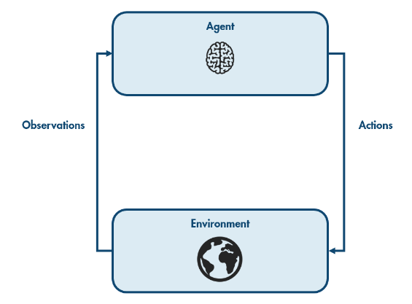
A reinforcement learning agent interacts with the environment by choosing actions based on observations.

Slide 3
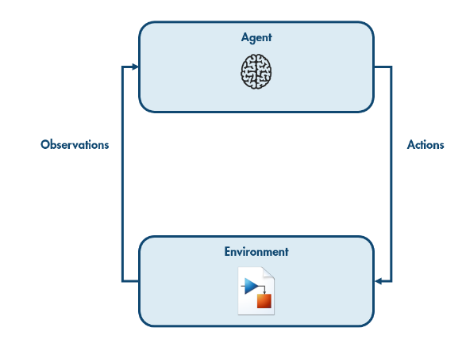
How the environment reacts to the agent's actions is typically simulated using a Simulink model of the environment's dynamics.

Slide 4
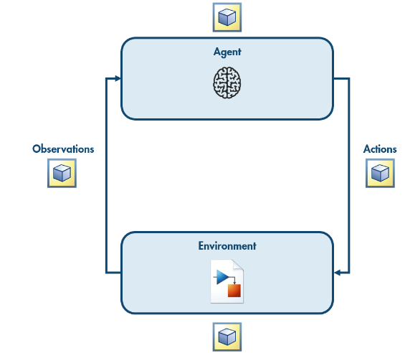
The agent, the environment, the observations, and the actions are all represented in MATLAB as variables.

Slide 5
The agent, the environment, the observations, and the actions are all represented in MATLAB as variables.

Slide 6
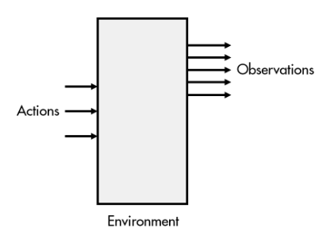
Connecting a Simulink Environment to a MATLAB Agent
To create a reinforcement learning environment, you will typically start with a Simulink model of the environment dynamics. The actions will control the inputs to the system. Observable variables will be the outputs.

Slide 7
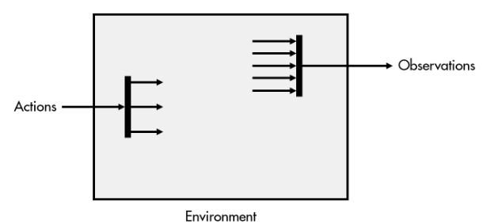
Connecting a Simulink Environment to a MATLAB Agent
When using an RL agent, the actions and observations are each single signals. You can use something like a Vector Concatenate block to combine the individual observations into a single array. You can use Selector blocks to split the action signal into individual actions.

Slide 8
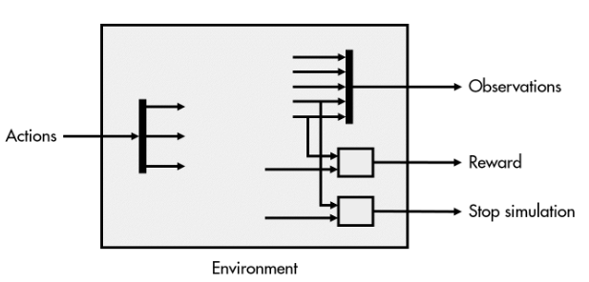
Connecting a Simulink Environment to a MATLAB Agent
The environment also needs to provide the reward. This is typically calculated from the observable variables and sometimes the actions. However, the reward may also depend on other environment variables that are not observable to the agent.
Similarly, the environment needs to determine whether the simulation should terminate, such as when the target reaches 0 in the dice game, or if the robot crashes into an obstacle. As with the reward, the termination condition may depend on the observable variables or other internal variables.

Slide 9
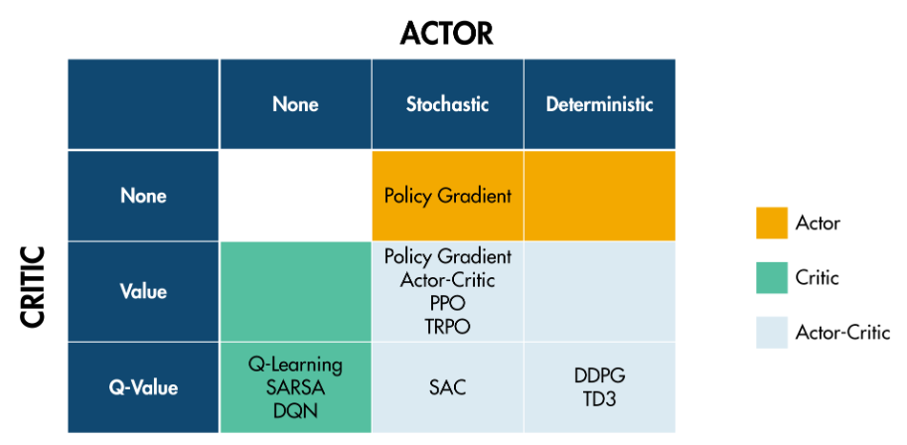
Actor-Critic Agents
There are various types of actor-critic agents, each using a particular architecture for the actor and critic networks. Unless you are building custom neural networks for your actors and critics, you do not need to worry about the different types of actors and critic networks. Typically, you will be able to create your agent by specifying just the observations and actions, resulting in an agent with default actor and critic networks chosen for you.

Slide 10
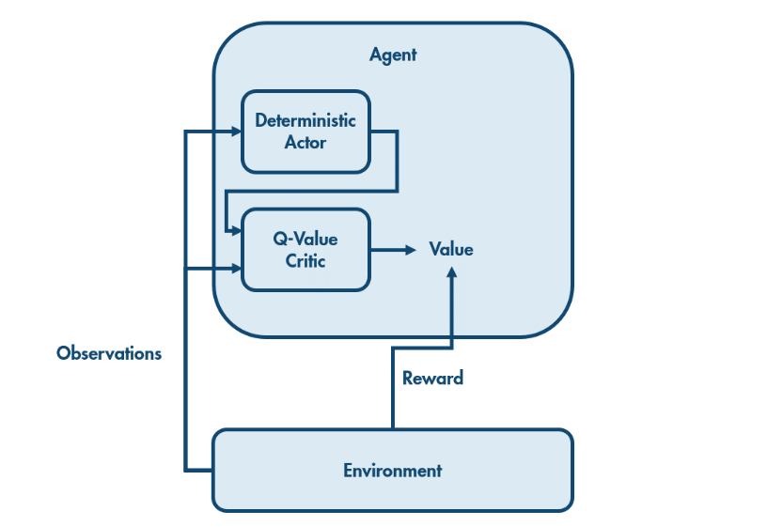
Deterministic Actor and Q-Value Critic
The environment provides a reward to the agent, and the agent observes the new state of the environment.
The actor uses the new state to determine a new action. This action and the new state are passed to the critic, which determines the value. That is, the critic estimates how much reward the agent will receive in the future from this situation. Combining this with the observed reward gives an updated estimate of the value of being in the original state.

